Slide 1
Transmission Impairment
The signal that is received may differ from the signal that is transmitted due to various transmission impairment.
Consequences
For analog signals, these impairments can degrade the signal quality.
For digital signals, bit errors may be introduced, such that a binary 1 is transformed into a binary 0 or vice versa.

Slide 2
Transmission Impairment

Slide 3
Impairment Causes
Transmission Impairments
Attenuation
Distortion
Noise
The imperfections of the medium causes impairments in the signal. What are the possible impairments? First is the attenuation, then distortion and noise.

Slide 4
Transmission Impairment considerations
Attenuation introduces three considerations for the transmission engineer.
First, a received signal must have sufficient strength so that the electronic circuitry in the receiver can detect the signal.
Second, the signal must maintain a level sufficiently higher than noise to be received without error.
Third, attenuation varies with frequency

Slide 5
The first and second problems are dealt with by attention to signal strength and the use of amplifiers or repeaters.
The third problem is dealt with equalizing attenuation across a band of frequencies. Another approach is to use amplifiers that amplify high frequencies more than lower frequencies.

Slide 6
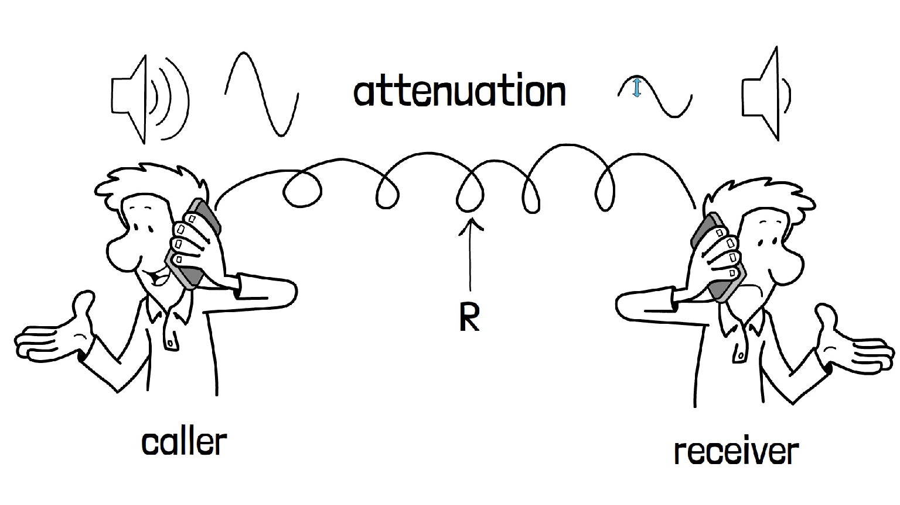
Attenuation: the loss of energy as the signal passes through a medium. Unit of measurement: Decibel
Figure refer by Techterm youtube channel

Slide 7
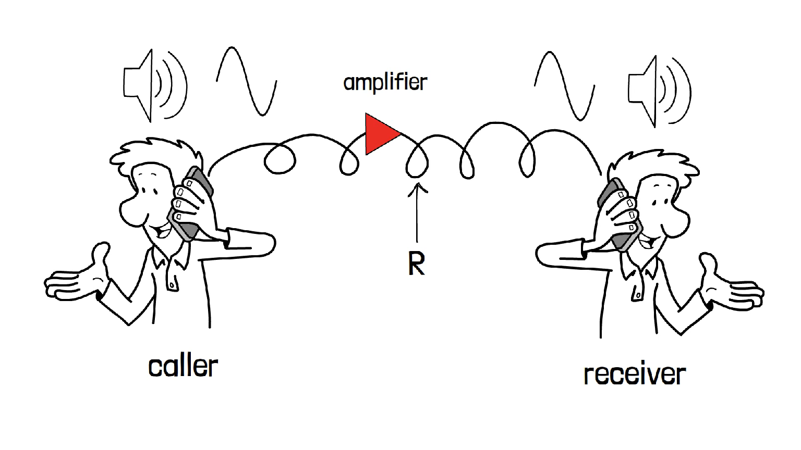
Amplifier
An amplifier can be used to compensate the attenuation of the medium
Figure refer by Techterm youtube channel

Slide 8
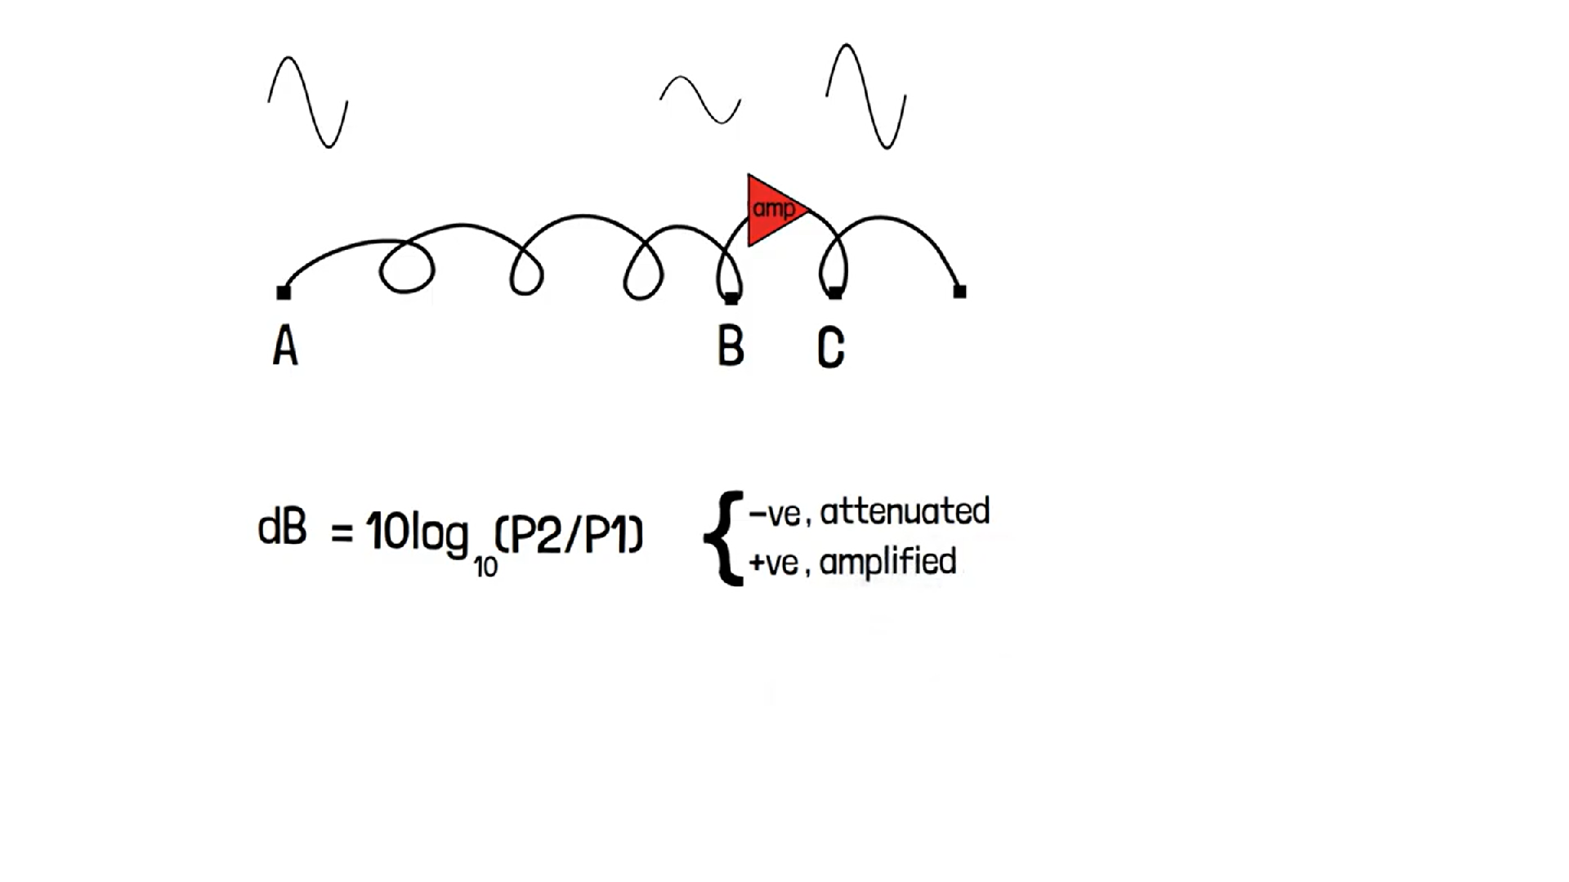
Unit to measure Strength is Decibel(dB)
dB = 10log10 P2/P1
Where,
P2 is the power at the destination or point 2
P1 is the power at the transmitting end or point P1.
Figure refer by Techterm youtube channel

Slide 9
A signal travels through a transmission medium and its power is reduced to one half. Calculate the Attenuation
Transmission medium
P1
P2
P2 = 0.5 P1
dB = 10 log ₁₀(P2/P1)
= 10 log ₁₀(0.5 P1/P1)
= 10 log ₁₀(0.5)
= 10 *(-0.3010)
= -3dB (Approx)

Slide 10
A signal travels through a amplifier and its power increased 20 times. Calculate the power gain
P1
P2
P2 = 20 P1
dB = 10 log ₁₀(P2/P1)
= 10 log ₁₀(20 P1/P1)
= 10 log ₁₀(20)
= 10 *(1.301)
= 13dB (Approx)

Slide 11
Delay distortion
Delay distortion arises particularly in a guided media but not in air.
Delay distortion arises because velocity of propagation varies with frequency.
That means this signal components that we are sending will have different velocities for different frequency components as it passes through a guided media and this leads to delay distortion.

Slide 12
Delay distortion (contd…)
Because of delay distortion, some of the signal components of one bit position will spill over into other bit positions, causing intersymbol interference
10001010➔10001001
Equalizing techniques(Delay Equalizer) can also be used to avoid delay distortion.

Slide 13
Noise
unwanted signals that are inserted somewhere between transmission and reception.
undesired signals are referred to as noise.
Noise is the major limiting factor in communications system performance.

Slide 14
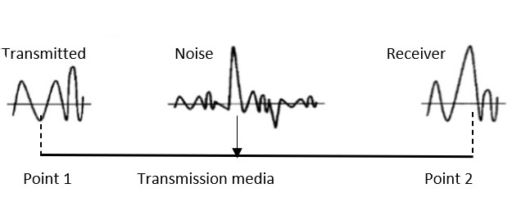


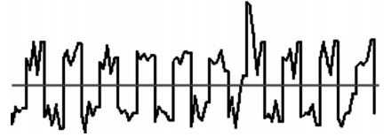
Noise
Original Signal
Noise Signal
receiver side the sender signal combine with nois

Slide 15
Noise
Noise may be divided into four categories:
Noise
Thermal
Intermodulation
Crosstalk
Impulse

Slide 16
Noise Type1: Thermal Noise (White noise)
Random motion of electrons in wire creates extra signal which is not sent by transmitter
Due to random motion of electrons.
Present in all transmission devices and media
is a Function of temperature
A kind of noise where the irregular electron movement in wire produces an additional signal.
Thermal noise is uniformly distributed across the bandwidths and hence is often referred to as white noise

Slide 17
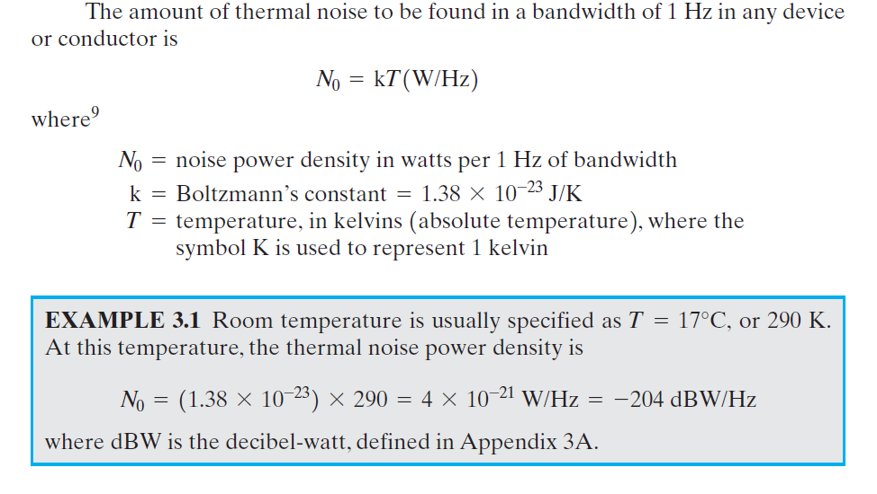
1°C + 273.15 = 274.15K
17°C + 273.15 = 290.15K

Slide 18
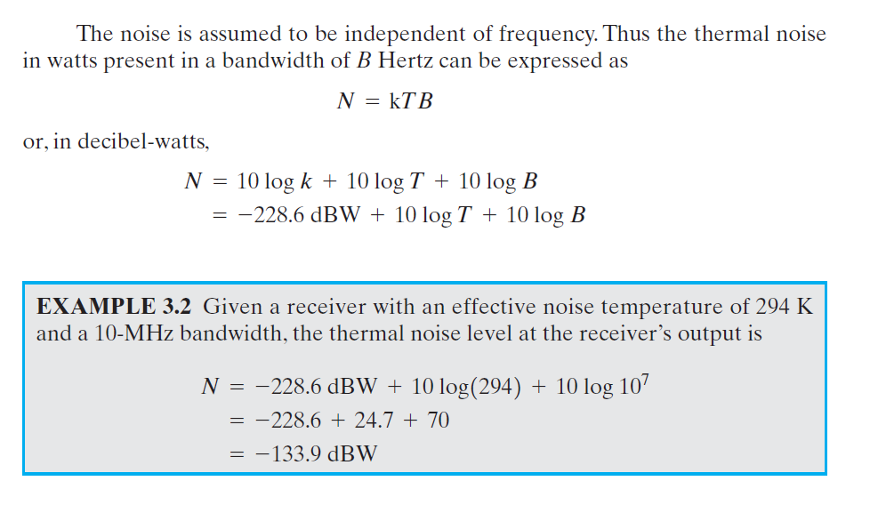

Slide 19
Noise Type2: Intermodulation Noise
When signals at different frequencies share the same transmission medium, the result may be intermodulation noise.
The effect of intermodulation noise is to produce signals at a frequency that is the sum or difference of the two original frequencies or multiples of those frequencies.
For instance, consider two signals S1 and S2 generate signals of frequencies (S1 + S2) and (S1 - S2) that may interfere with the signals of the same frequencies sent by the sender. In any part of the communication system, intermodulation noise is introduced because of this situation.
Intermodulation noise is produced by nonlinearities in the transmitter, receiver and/or intervening transmission medium.

Slide 20
Noise Type3: Cross Talk
crosstalk is due to unwanted coupling between two media.
In telephone network, we frequently encounter crosstalk.
We hear some unwanted talk going on in the background. This is because of this unwanted coupling between two transmission media that means cables.
It can occur by electrical coupling between nearby twisted pairs or rarely coaxial cable lines carrying multiple signals

Slide 21
Noise Type4: Impulse noise
All of the types of noise discussed so far have reasonably predictable and relatively constant magnitudes.
Thus, it is possible to engineer a transmission system to cope with them.
Impulse noise, however, is noncontinuous, consisting of irregular pulses or noise spikes of short duration and of relatively high amplitude.
It is generated from a variety of causes, including external electromagnetic disturbances, such as lightning, and faults and flaws in the communications system.

Slide 22
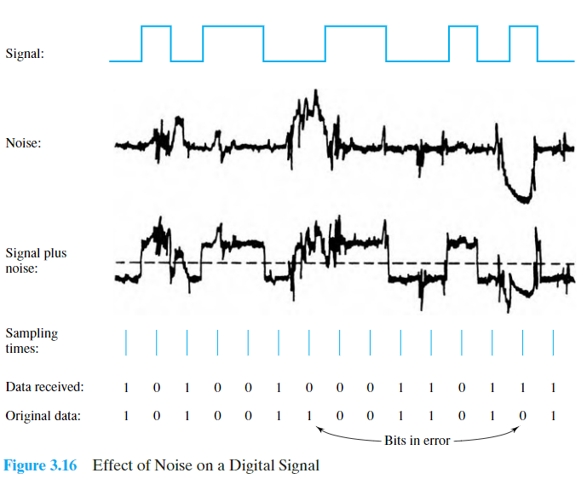

Slide 23
Channel Capacity
The maximum rate at which data can be transmitted over a given communication path, or channel, under given conditions, is referred to as the channel capacity.
There are four concepts here that we are trying to relate to one another.
Data rate : The rate, in bits per second (bps), at which data can be communicated
Bandwidth: The bandwidth of the transmitted signal as constrained by the transmitter and the nature of the transmission medium, expressed in cycles per second, or Hertz
Noise : The average level of noise over the communications path
Error rate : The rate at which errors occur, where an error is the reception of a 1 when a 0 was transmitted or the reception of a 0 when a 1 was transmitted
Two theoretical models: (Calculate Data rate)
Nyquist Capacity : assumes noise-free environment
Shannon Capacity : considers noise

Slide 24
Nyquist Capacity
Assumes channel that is noise free, the only limitation on the data rate is bandwidth.
Given a bandwidth of B, the highest signal rate is 2B, then a signal with frequencies no greater than B is sufficient to carry the signal rate.
Single signal element may carry more than 1 bit; signal with M levels may carry log₂ M bits
C = 2B log₂M
Tradeoffs:
Increase the bandwidth, increases the data rate.
Increase the signal levels, increases the data rate.
Increase the signal levels, harder for receiver to interpret the bits (practical limit to M)

Slide 25
A noiseless channel has a bandwidth of 4000 Hz and is transmitting a signal with two signal with two signal levels. Calculate the maximum bit rate
B=4000Hz
M=2
C = 2B log₂M
Bit Rate = 2 * 4000 * log₂2
= 2 * 4000 * 1
=8000 bps

Slide 26
A noiseless channel has a bandwidth of 4000 Hz and is transmitting a signal with two signal with four signal levels. Calculate the maximum bit rate
B=4000Hz
M=4
C = 2B log₂M
Bit Rate = 2 * 4000 * log₂4
= 2 * 4000 * 2
=16000 bps

Slide 27
Consider a noiseless channel with a bandwidth of 20 KHz. We need to send 280 Kbps over a channel. How many signal levels are required?
C =280 Kbps
B = 20 KHz
C = 2B log₂M Log _{a} x = y
280 = 2 * 20 * log₂ M x = a^{y}
280/40 = log₂ M
7 = log₂ M
M = 2⁷
M = 128

Slide 28
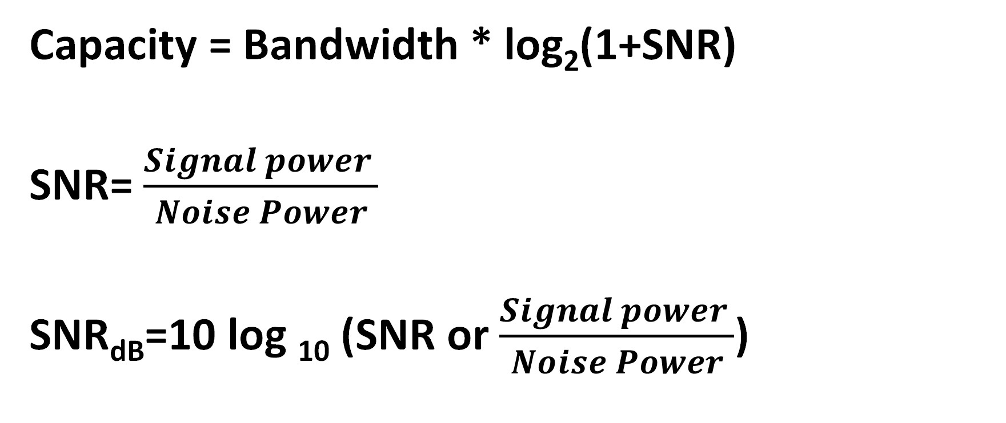
Shannon Capacity : Noisy channel
Capacity = Bandwidth * log₂(1+SNR)
SNR= $\frac{Signal power }{Noise Power}$
SNR_{dB}=10 log ₁₀ (SNR or $\frac{Signal power }{Noise Power}$)

Slide 29
Let us consider an example that relates the Nyquist and Shannon formulations. Suppose that the spectrum of a channel is between 3 MHz and 4 MHz and SNR_{dB} = 24 dB. Then
B = 4 MHz - 3 MHz = 1 MHz
SNR_{dB} = 24 dB = 10 log ₁₀(SNR)
SNR = 251
Using Shannon’s formula,
C = 10⁶ * log ₂ (1+251)
= 10⁶ * 8
= 8 Mbps
Nyquist formula,
B= 10⁶ Hz
C = 8 Mbps
C = 2B log₂M Log _{a} x = y
8 * 10⁶ = 2 * 10⁶ * log₂ M x = a^{y}
4 = log₂ M
M = 16

Slide 30
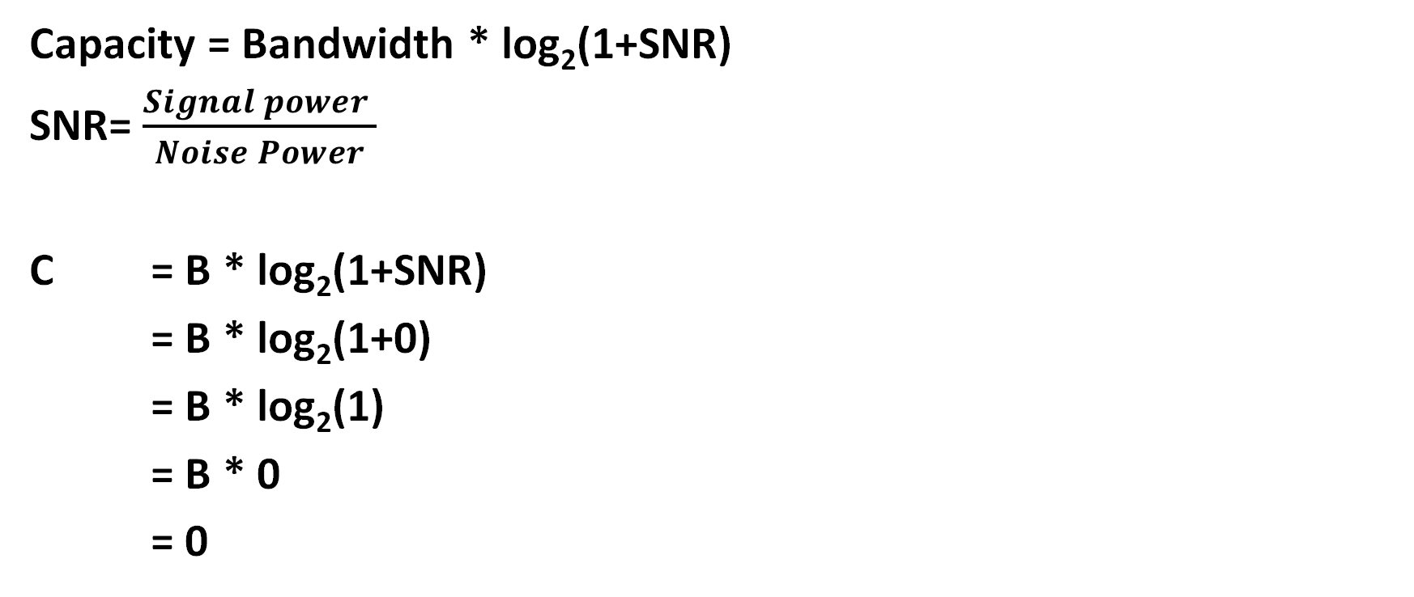
Consider a extremely noisy channel in which signal to noise ratio is almost zero. Calculate the capacity of the channel
Capacity = Bandwidth * log₂(1+SNR)
SNR= $\frac{Signal power }{Noise Power}$
C = B * log₂(1+SNR)
= B * log₂(1+0)
= B * log₂(1)
= B * 0
= 0

Slide 31
Calculate the highest bit rate(capacity of the channel) if the bandwidth is 3000 Hz and signal to noise ration(SNR) is 3162
B = 3000 Hz
SNR = 3162
C = B * log₂(1+SNR)
= 3000 * log₂(1+3162)
= 3000 * log₂(3163)
= 3000 * 11.627
= 34881 bps

Slide 32
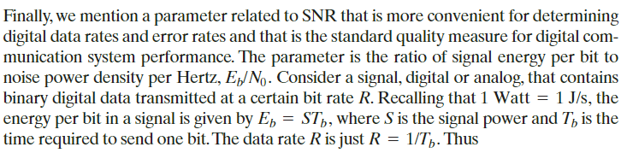
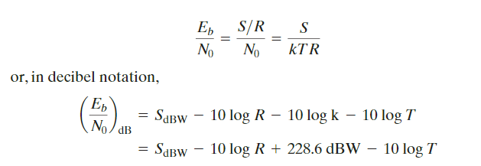
Expression E_{b}/N₀

Slide 33
Tutorial-1 Questions
A channel has B=4kHz and SNR =30dB. Determine maximum information rate for 128 level encoding.
We need to send 256 kbps over a noiseless channel with a bandwidth 20 KHz. How many signal levels do we need?
We have a channel with a 1 Mhz bandwidth. The SNR_db for this channel is 63db.What are the appropriate bit rate and signal level?
A telephone system with modem allows bandwidth of 3100 Hz. What is the maximum data rate? M=2

Slide 34
Tutorial-1 Question-1 Solution
1. A channel has B=4kHz and SNR =30dB. Determine maximum information rate for 128 level encoding.
B=4KHz
SNR=30db
SNR_db=10 log10(SNR)
30=10 lag10(SNR)
SNR=10^(30/10)=1000
C = B log₂ (1 + SNR)
C=4k log2(1+1000)
C=4k*9.96
C=39.8Kbps
C = 2B log₂ M
C=8k *log2(128)
C=8k*7
C=56Kbps
Nyquist capacity=56kbps
Shannon capacity=39.8kbps
Smallest of two values decide channel capacity.

Slide 35
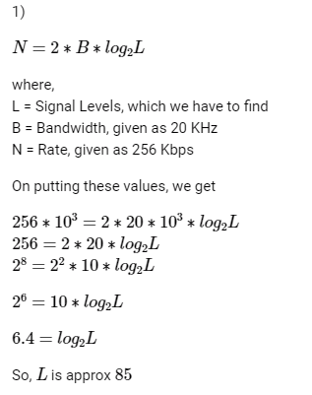
Tutorial 1 Question-2 Solution
2)We need to send 256 kbps over a noiseless channel with a bandwidth 20 KHz. How many signal levels do we need?

Slide 36
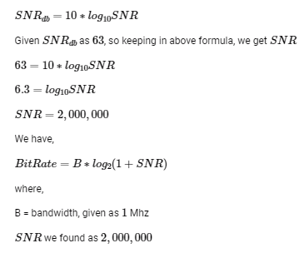
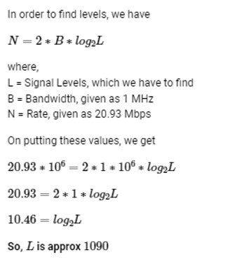
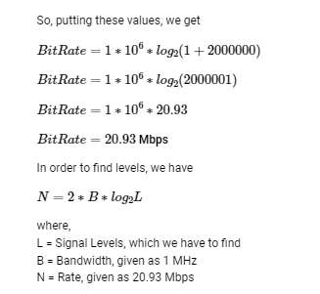
Tutorial 1 Question-3
3) We have a channel with a 1 Mhz bandwidth. The SNRdb for this channel is 63db.What are the appropriate bit rate and signal level?

Slide 37
Tutorial 1 Question-4
A telephone system with modem allows bandwidth of 3100 Hz. What is the maximum data rate? M=2
C = 2B log2M Nyquist Formula
C=2*B log2 (2)
C=2*3100*1
C=6200 bps

